Slide 1
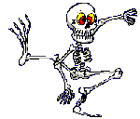
THE SKELETAL SYSTEM
Skeleton and Joints

Slide 2
Learning goals
By the end of this unit you should be able to:
identify and describe the main functions of the skeleton
Identify and describe the different types of joints and give examples of articulating bones associated with the joints
Identify different ranges of movement that are allowed by joints

Slide 3
What you need to know :
The main functions of the skeleton including lever action
How physical activity impacts on the skeletal system
The structure of the hinge joint and ball and socket joint with examples
The operation of the hinge joint and ball and socket joint in terms of flexion extension adduction abduction rotation with examples
The articulating bones associated with the hinge joint and ball and socket joint with examples
The structure and function of cartilage and ligaments and associated problems and how to avoid them
Problems with joints and how to avoid them

Slide 4
Functions of the Skeleton
Shape and support
Movement
Protection
Blood production

Slide 5
1. Shape and Support
CRANIUM
MANDIBLE
SCAPULA
CLAVICLE
HUMERUS
STERNUM
VERTEBRAL
COLUMN
RIBS
RADIUS
ILIUM
PELVIS
ULNA
CARPALS
METACARPALS
FEMUR
PHALANGES
TIBIA
PATELLA
FIBULA
TARSALS
PHALANGES
METATARSALS

Slide 6
1. Shape and Support
The way bones are arranged gives us our general framework and shape
Sportspeople will all have different shapes because of their framework.
Different builds are more suited to certain sports.
Bones are firm and rigid they can support the rest of the body and keep us upright.
Muscles are attached to the skeleton and it is bones that act as a framework for them.

Slide 7
2. Movement
When bones work with muscles they allow the body to move.
Bones are used by muscles as levers that allow movement.

Slide 8
3. Protection
Some bones help protect the internal organs of the body.
In some sports where contact is high this is especially important.

Slide 9
4. Blood production
In the long bones of the body the production of red and white blood cells takes place.

Slide 10
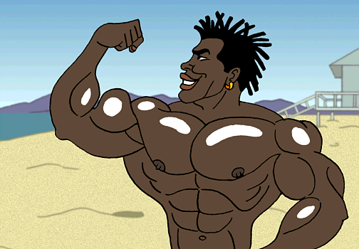
THE MUSCULAR SYSTEM

Slide 11
Learning goals
By the end of this unit you should be able to
identify and describe the composition of skeletal muscle
identify and describe different muscle fibre types
describe the roles of muscles in movement including the role of antagonistic pairs,
describe the role and function of tendons

Slide 12
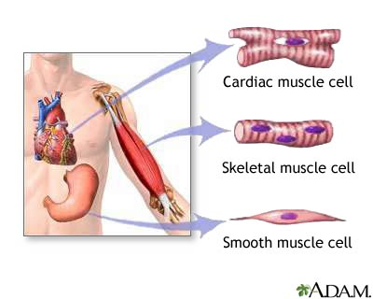
Types of muscle
Approximately 45% of or body weight is muscle
There are 3 types of muscle tissue
1. voluntary / skeletal muscle which are attached to the skeleton and which we control.
2. involuntary muscle which are not under our control and contract / relax automatically
3. cardiac muscle found in the wall of the heart that will never tire as long as it has a good blood supply

Slide 13
SKELETAL MUSCLE
Muscle is made of protein
Skeletal muscle is made up of cylindrical fibres
Skeletal muscle cells are long and thin
All these muscles are attached to the skeleton
These muscles pull on bones to create movement

Slide 14
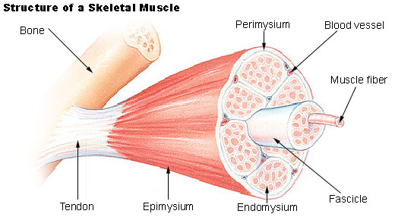
Skeletal muscle
Muscles are made of many fibres
Each fibre contains many myofibrils

Slide 15
MUSCLES AND MOVEMENT
The skeleton provides attachment for the muscles
Muscles contract against the skeleton to move
Most muscles are long and thin, when they contract they get shorter and thicker

Slide 16
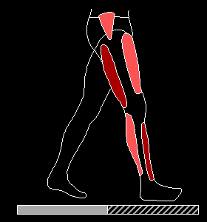
Muscle and movement
Muscles are attached to the bones by tendons.
Muscles are attached at both ends. At the origin to something rigid and at the insertion which is the bone it moves.
Muscles work in pairs. One muscle contracts whilst the other relaxes. This is called antagonistic action.

Slide 17
THE SKELETAL SYSTEM
Joints

Slide 18
The Skeleton and movement

Slide 19
The skeleton and movement
Bones help a sportsperson move efficiently
Long bones create leverage when playing a sport helping generate speed, force and power.
Flat bones are tough and can withstand impact e.g. in a rugby tackle the pelvis and rib cage protects a player’s organs
Short bones specialise in fine movement e.g. Putting the spin on a ball in cricket, or small adjustments to aid balance in a gymnast
Irregular bones work together as a shock absorber e.g. A basketball player landing from a jump shot will rely on the vertebrae to reduce the shock on their back.

Slide 20
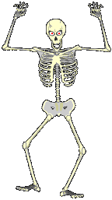
joints
Joints are where two bones meet.
There are three types depending on how much movement they allow.
Different joints allow the body to move in different ways. Muscles pull against the bones to create movement.

Slide 21
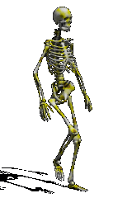
MOVEMENT AT A JOINT
FLEXION - a decrease in the angle between two bones e.g. Biceps curl
EXTENSION – an increase in the angle between two bones e.g. In a press up, kicking a ball
ADDUCTION – movement towards the mid line of the body e.g. crossover step in javelin
ABDUCTION – movement away from the midline of the body e.g. Cartwheel
ROTATION – movement in the horizontal plane on a longitudinal axis e.g. Butterfly stroke swimming

Slide 22
Synovial / freely moveable joints
They are freely movable joints and are present at the elbow, ankle, hip, wrist and knee.
In synovial joints the articular surfaces of the bones are covered with a smooth piece of hyaline cartilage.
The space between the ends of the bones is filled with a slippery fluid called synovial fluid.
The cavity or space is lined by a membrane, the synovial membrane. The synovial fluid and the cartilage allow free movement of bones at the joints.
Synovial joints are classified into various types according to the nature of articulation and the degree of movement they allow.

Slide 23
Synovial joint
BONE
SOFT TISSUE
LIGAMENT
SYNOVIAL MEMBRANE
JOINT CAPSULE
CARTILAGE
SYNOVIAL CAVITY CONTAINING SYNOVIAL FLUID

Slide 24
Synovial joints
Cartilage – acts as a cushion and creates a barrier reducing the amount of friction
Synovial fluid – lubricates the joint allowing the parts to move against each other smoothly. It also keeps the joint free from infection.
Synovial capsule – a tough fibre that surrounds the joint holding the fluid in place
Synovial membrane – lies inside the capsule and produces synovial fluid
Ligament – surround the sides of the joint and are made of tough elastic fibres. They hold the bones in place and attach bone to bone

Slide 25
Types of synovial joints
A hinge joint enables flexion and extension to occur.
Movement is along one plane only.
E.g. Elbow, knee

Slide 26
Types of synovial joints
FLEXION AND EXTENSION IN A HINGE JOINT

Slide 27
Types of synovial joints
Called ball and socket because the head of a long bone is shaped like a ball and fits into a socket in the shape of a cup.
Allows movement along several planes.
Ball and socket joint allows flexion, extension, adduction, abduction and rotation.
E.g. Hip, shoulder

Slide 28
Types of synovial joints
ADDUCTION AND ABDUCTION IN A BALL AND SOCKET JOINT

Slide 29
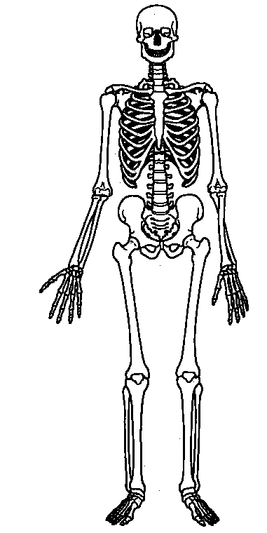
SKULL - FIXED
NECK - PIVOT
SHOULDER – BALL AND SOCKET
STERNUM / RIBS – SLIGHTLY MOVEABLE
ELBOW - HINGE
VERTEBRAE– SLIGHTLY MOVEABLE
HIP – BALL AND SOCKET
RADIUS/ULNA - PIVOT
THUMB - SADDLE
WRIST – CONDYLOID AND GLIDING
KNEE - HINGE
ANKLE - HINGE

